Slide 1
Shellsort

Slide 2
Shellsort
Shell sort is a highly efficient sorting algorithm and is based on insertion sort algorithm. This algorithm avoids large shifts as in case of insertion sort if smaller value is very far right and have to move to far left.

Slide 3
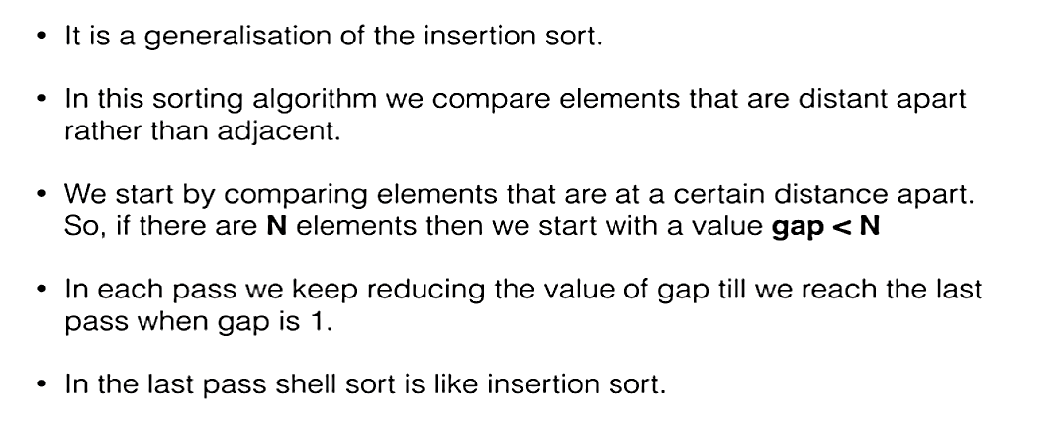
Shellsort

Slide 4
Shellsort
Shell sort uses a sequence h₁, h₂, …, h_{t} called the increment sequence. Any increment sequence is fine as long as h₁ = 1 and some other choices are better than others.

Slide 5
Shellsort
Shellsort makes multiple passes through a list and sorts a number of equally sized sets using the insertion sort.

Slide 6
Shellsort
Shellsort improves on the efficiency of insertion sort by quickly shifting values to their destination.

Slide 7
Shellsort
Shellsort is also known as diminishing increment sort.
The distance between comparisons decreases as the sorting algorithm runs until the last phase in which adjacent elements are compared

Slide 8
Shellsort
After each phase and some increment h_{k}, for every i, we have a[ i ] ≤ a [ i + h_{k} ] all elements spaced h_{k} apart are sorted.
The file is said to be h_{k} – sorted.

Slide 9
Empirical Analysis of Shellsort (Advantage)
Advantage of Shellsort is that its only efficient for medium size lists. For bigger lists, the algorithm is not the best choice. Fastest of all O(N^2) sorting algorithms.
5 times faster than the bubble sort and a little over twice as fast as the insertion sort, its closest competitor.

Slide 10
Empirical Analysis of Shellsort (Disadvantage)
Disadvantage of Shellsort is that it is a complex algorithm and its not nearly as efficient as the merge, heap, and quick sorts.
The shell sort is still significantly slower than the merge, heap, and quick sorts, but its relatively simple algorithm makes it a good choice for sorting lists of less than 5000 items unless speed important. It's also an excellent choice for repetitive sorting of smaller lists.

Slide 11
Shellsort Best Case
Best Case: The best case in the shell sort is when the array is already sorted in the right order. The number of comparisons is less.

Slide 12
Shellsort Worst Case
The running time of Shellsort depends on the choice of increment sequence.
The problem with Shell’s increments is that pairs of increments are not necessarily relatively prime and smaller increments can have little effect.

Slide 13
Shellsort Examples
Sort: 18 32 12 5 38 33 16 2
8 Numbers to be sorted, Shell’s increment will be floor(n/2)
* floor(8/2) ➔ floor(4) = 4
increment 4:
1 2 3 4
(visualize underlining)
18 32 12 5 38 33 16 2
Step 1) Only look at 18 and 38 and sort in order ;
18 and 38 stays at its current position because they are in order.
Step 2) Only look at 32 and 33 and sort in order ;
32 and 33 stays at its current position because they are in order.

Slide 14
Shellsort Examples
Sort: 18 32 12 5 38 33 16 2
8 Numbers to be sorted, Shell’s increment will be floor(n/2)
* floor(8/2) ➔ floor(4) = 4
increment 4:
1 2 3 4
(visualize underlining)
18 32 12 5 38 33 16 2
Step 3) Only look at 12 and 16 and sort in order ;
12 and 16 stays at its current position because they are in order.
Step 4) Only look at 5 and 2 and sort in order ;
2 and 5 need to be switched to be in order.

Slide 15
Shellsort Examples (con’t)
Sort: 18 32 12 5 38 33 16 2
Resulting numbers after increment 4 pass:
18 32 12 2 38 33 16 5
* floor(4/2) ➔ floor(2) = 2
increment 2:
1 2
18 32 12 2 38 33 16 5
Step 1) Look at 18, 12, 38, 16 and sort them in their appropriate location:
12 38 16 2 18 33 38 5
Step 2) Look at 32, 2, 33, 5 and sort them in their appropriate location:
12 2 16 5 18 32 38 33

Slide 16
Shellsort Examples (con’t)
Sort: 18 32 12 5 38 33 16 2
* floor(2/2) ➔ floor(1) = 1
increment 1:
1
12 2 16 5 18 32 38 33
2 5 12 16 18 32 33 38
The last increment or phase of Shellsort is basically an Insertion
Sort algorithm.

Slide 17
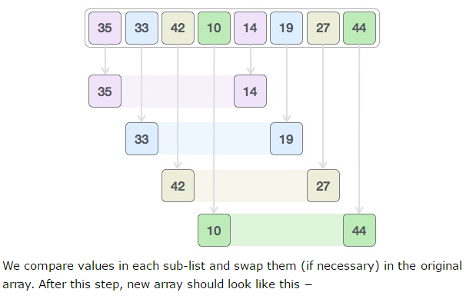
Example-2
For our example and ease of understanding we take the interval of 4. And make a virtual sublist of all values located at the interval of 4 positions. Here these values are {35, 14}, {33, 19}, {42, 27} and {10, 14}

Slide 18
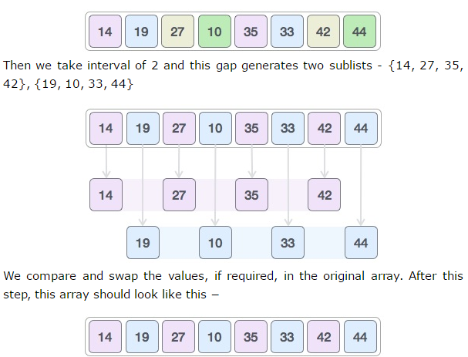
Example-2

Slide 19
  int tmp;
  for (int gap = N/2; gap > 0; gap = gap/2){
  for ( int p = gap; p < N ; p++){
  tmp = a[p];
  for (int j = p; j >= gap && tmp < a[j- gap]; j = j - gap){
  a[j] = a[j-gap];
  }
  a[j] = tmp;
  }
  }

